Slide 1


SecureFlow
AI-native vendor security questionnaire automation
Upload your security policies → import customer SIG / CAIQ / custom Excel → generate AI drafts with citations → human review → export CSV.
Go-to-market: hosted SaaS — customers never bring an API key; platform OPENAI + Stripe ($19.99/mo Starter) + metered rows.
Live MVP + billing
Stripe + usage limits
SIG · CAIQ · Excel · CSV
Shipped in the live MVP
Team workspaces · RBAC · vault · XLSX/CSV import · RAG + citations
Per-row regen · approve · audit log · CSV export · Billing page
Stripe Checkout + webhooks + monthly AI row metering (free + Starter)
SecureFlow · Confidential
contact@secureflow.tech · secureflow.tech

Slide 2
The problem
Enterprise revenue stalls on security paperwork
SIG, SIG Lite, CAIQ, custom Excel, RFIs, DDQs — enterprise deals routinely stall on vendor security questionnaires.
10–500 person B2B SaaS teams answer from scattered PDFs, Slack threads, and old CSVs → inconsistent answers and legal risk.
TPRM / GRC platforms target buyer-side, high-ACV enterprise. The vendor-side long tail lives in manual spreadsheets.
Questionnaires are revenue infrastructure — but most companies treat them like one-off homework every quarter.
Enterprise DD
SIG · CAIQ · custom Excel
Fragmented answers
Docs · Slack · old CSVs
Inconsistency risk
Legal + audit exposure
Slower revenue
Procurement queue stalls
Vendor-side pain chain ↑
SecureFlow · Confidential

Slide 3
Market opportunity
Large TAM — sharp wedge entry
TAM (directional): global GRC / TPRM / risk software and services — $20B+, growing with regulation and board scrutiny.
SAM: B2B SaaS vendors selling into regulated and enterprise buyers — hundreds of thousands of companies.
SOM wedge: vendor-side teams who adopt a $19.99/mo Starter (usage-metered) before buying six-figure GRC suites.
Why now: RAG makes citation-backed drafting reliable; buyers demand traceability, not generic ChatGPT prose.
TAM
$20B+
GRC / TPRM / risk services
SAM
$3–5B
B2B SaaS → enterprise buyers
SOM
$150–400M
$19.99/mo Starter + usage · land before GRC suites
SecureFlow · Confidential

Slide 4
Product — how SecureFlow works
End-to-end workflow, live today
1 Knowledge vault Upload PDF, DOCX, TXT, MD, CSV. Text is chunked, embedded, and indexed per workspace. 2 Import questionnaire Customer CSV or Excel — pick the sheet and question column; preview before committing. 3 Generate drafts RAG retrieves best chunks; LLM drafts with JSON citations (source file + excerpt). Match score per row. 4 Review & ship Edit inline, approve rows, regenerate single rows. Export CSV ready for the buyer.
Vault
Import
RAG + Cite
Review
CSV export
Upload docs
CSV / Excel
AI drafts
Edit / approve
Send to buyer
Key differentiator: narrow wedge + citations + row workflow + hosted SaaS (or self-host for dev). Not a generic chatbot.
SecureFlow · Confidential

Slide 5
What's live today
Running codebase — not slideware
Core product
Platform & GTM
Team workspaces — shared vault & questionnaires
Next.js 16 (App Router) · TypeScript · Tailwind CSS
Roles: ADMIN · EDITOR · VIEWER (workspace-scoped)
Prisma + SQLite (MVP) — Postgres for multi-instance
Per-workspace document + questionnaire isolation
Email/password auth + Google OAuth (one-click sign-in)
Match confidence score per row (retrieval)
Stripe Checkout + Customer Portal + webhooks (live)
Human edit + per-row approve flag
Free tier (25 rows) · Starter $19.99/mo (2,000 rows) · Custom
Single-row regenerate (no full re-run needed)
Vitest test suite — passing in CI
CSV export: question, answer, approved, score, sources
Marketing: SEO blog, whitepaper, pricing, tutorial, FAQ
Audit log on export (who / what / when)
Brand art + favicons + manifest + sitemap + robots
SecureFlow · Confidential

Slide 6
Architecture (MVP)
RAG pipeline — clear path from prototype to scale
Pipeline: extract text → sliding-window chunks → embeddings → hybrid cosine + keyword retrieval → grounded LLM completion.
Hosted SaaS: one platform OPENAI_API_KEY; tenants isolated by workspace. Dev path: Ollama or demo mode without keys.
Storage: filesystem per workspace on MVP VPS; scale-out: S3-compatible + Postgres + job queue.
Explicit non-goal: SecureFlow drafts and cites — it does not certify compliance or replace the CISO.
Docs
Chunk
Embed
Retrieve
LLM
PDF/DOCX/CSV
Sliding window
OpenAI / Ollama
Cosine + keyword
Draft + citations
→ Human-approved CSV sent to buyer
Privacy
Cloud models send document text to the provider for embeddings and completion. For sensitive pilots, run Ollama locally or in a private VPC endpoint.
SecureFlow · Confidential

Slide 7
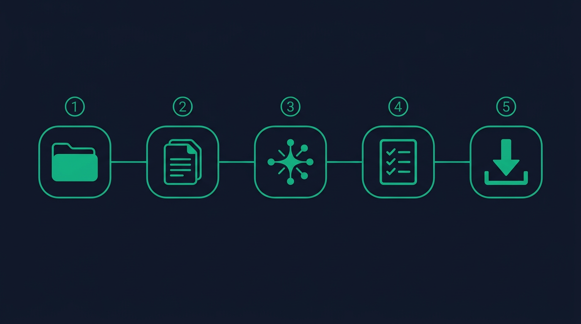
Demo walk-through
2-minute live path — add your own screenshots
1
2
3
Knowledge vault
Questionnaire + RAG
Review & export
Upload policy PDFs,
past answers, runbooks
Import Excel/CSV,
generate cited drafts
Edit, approve rows,
download CSV for buyer
Live path: email or Google sign-in → vault PDF → import SIG Excel → Generate drafts → citations + scores → edit → export CSV.
SecureFlow · Confidential

Slide 8
Business model
Land on ROI, expand with workflow
Land with Stripe Starter at $19.99/mo — low friction, no procurement committee for first paid seat.
Gross margin: one platform OpenAI key; usage caps protect COGS — upgrade path to Enterprise for custom limits.
Expand: answer intelligence, integrations (Slack, Drive), SSO — Postgres + jobs for scale.
1
Free tier + pilots
2
Starter $19.99/mo
3
Enterprise
Generous free row quota
Prove hours saved per 100 rows
Stripe subscription
Higher monthly row limits · portal cancel
Custom limits · SSO
Contact sales · Postgres scale-out
SecureFlow · Confidential

Slide 9
Traction & roadmap
Full MVP shipped · pilot phase underway
✓ SHIPPED
Full MVP loop: vault → import → RAG → review → export | Google OAuth, Team workspaces, RBAC, billing, audit log, SEO site
TBD
TBD
TBD
TBD
Beta
signups
Questionnaires
run in pilot
Median hours
saved (reported)
Design partners
/ LOIs
Next 12 months
Answer intelligence & reuse — surface similar approved answers across questionnaires
Integrations — Jira, Slack, Google Drive, trust-center APIs
Postgres + background job queue — scale beyond single-server SQLite
Enterprise SSO & compliance packaging — SOC 2 report, MFA, SSO, data residency options
SecureFlow · Confidential

Slide 10
Competitive landscape
We own the vendor's spreadsheet — not the buyer's TPRM suite
Segment | Examples | SecureFlow angle
Enterprise GRC / TPRM | Large VRM suites | High ACV, buyer-side focus. SMB vendors still drown in Excel
Horizontal AI / doc Q&A | ChatGPT / Claude | No row workflow, no vault traceability — analysts can't verify sources
Trust centers | Vanta, Drata (public pages) | Complements SecureFlow — doesn't replace custom questionnaire responses
SecureFlow | — | Hosted SaaS + Stripe · RAG + citations · row workflow · CSV · optional self-host
SecureFlow · Confidential

Slide 11

Team
Founder-led · building in public
?
?
Sam Kan
Engineering
Advisors
CEO & Founder
CTO — open role
Network forming
Product vision, GTM strategy, and enterprise security questionnaire workflows.
Security-minded full-stack / ML engineer. Reach out if you know someone exceptional.
GRC, security leadership, and B2B SaaS GTM. Introductions welcome.
SecureFlow · Confidential

Slide 12
The ask
Pre-seed / seed round
$
→
✓
Raising
Use of funds
Why SecureFlow
[$X] for 18–24 months
Product hardening + first paid pilots + enterprise feature build-out
Engineering (reliability, SSO, scale)
GTM: security + sales leadership
Security posture for mid-market buyers
Hosted SaaS motion live (Stripe + metering)
Clear ICP · citation-first workflow
MVP in market — not slideware
This deck is for discussion only and does not constitute an offer to sell or solicitation to buy securities.
SecureFlow · Confidential · Not an offer of securities

